Slide 1

Chapter 8
Abstract Data Types and Subprograms

Slide 2
Chapter Goals (1 of 2)
Distinguish between an array-based visualization and a linked visualization
Distinguish between an array and a list
Distinguish between and an unsorted list and a sorted list
Distinguish between the behavior of a stack and a queue
Distinguish between the binary tree and a binary search tree

Slide 3
Chapter Goals (2 of 2)
Draw the binary search tree that is built from inserting a series of items
Understand the difference between a tree and a graph
Explain the concept of subprograms and parameters and distinguish between value and reference parameters

Slide 4
Abstract Data Types
Abstract Data Type
A data type whose properties (data and operations) are specified independently of any particular implementation
Remember what the most powerful tool is for managing complexity?

Slide 5
Three Views of Data (1 of 4)
Application (User) Level
View of the data within a particular problem
View sees data objects in terms of properties and behaviors

Slide 6
Three Views of Data (2 of 4)
Logical (Abstract) Level
Abstract view of the data and the set of operations to manipulate them
View sees data objects as groups of objects with similar properties and behaviors

Slide 7
Three Views of Data (3 of 4)
Implementation Level
A specific representation of the structure that hold the data items and the coding of the operations in a programming language
View sees the properties represented as specific data fields and behaviors represented as methods implemented in code

Slide 8
Three Views of Data (4 of 4)
Composite Data Type
A data type in which a name is given to a collection of data values
Data Structures
The implementation of composite data fields in an abstract data type
Containers
Object’s whole role is to hold and manipulate other objects

Slide 9
Logical Implementations
Two logical implementations of containers:
Array-based Implementation
Objects in the container are kept in an array
Linked-based Implementation
Objects in the container are not kept physically together, but each item tells you where to go to get the next one in the structure
Did you ever play treasure hunt, a game in which each clue
told you where to go to get the next clue?

Slide 10
Stacks (1 of 2)
Stack
An abstract data type in which accesses are made at only one end
LIFO, which stands for Last In, First Out
The insert is called Push and the delete is called Pop
Name three everyday
structures that are stacks.

Slide 11
Stacks (2 of 2)
WHILE (more data)
Read value
Push(myStack, value)
WHILE (NOT IsEmpty(myStack))
Pop(myStack, value)
Write value
Can you simulate this algorithm with
physical objects?
11
Notes:
11

Slide 12
Queues (1 of 2)
Queue
An abstract data type in which items are entered at one end and removed from the other end
FIFO, for First In, First Out
No standard queue terminology
Enqueue, Enque, Enq, Enter, and Insert are used for the insertion operation
Dequeue, Deque, Deq, Delete, and Remove are used for the deletion operation.
Name
three
everyday
structures
that are
queues.

Slide 13
Queues (2 of 2)
WHILE (more data)
Read value
Enque(myQueue, value)
WHILE (NOT IsEmpty(myQueue))
Deque(myQueue, value)
Write value
Can you simulate this algorithm with
physical objects?
Notes:
13

Slide 14
Lists
Think of a list as a container of items
Here are the logical operations that can be applied to lists:
Add item Put an item into the list
Remove item Remove an item from the list
Get next item Get (look) at the next item
More items Are there more items?

Slide 15
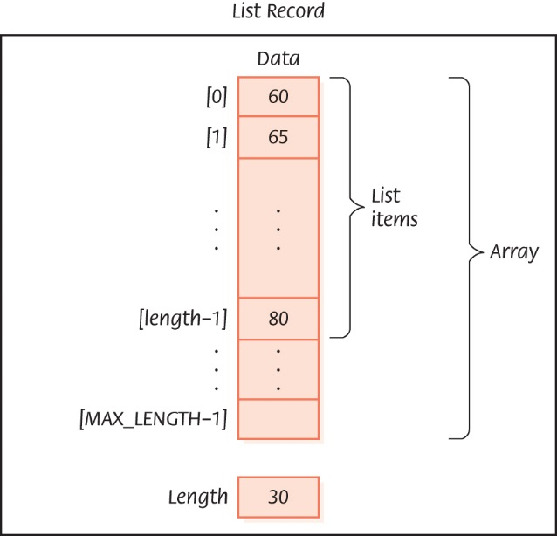
Array-Based Implementations
A sorted list of integers

Slide 16
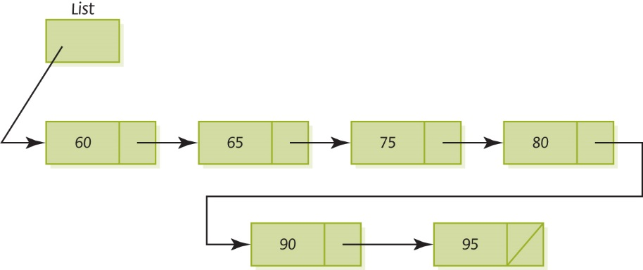
Linked Implementations
A sorted linked list

Slide 17
Algorithm for Creating and Printing Items in a List
WHILE (more data)
Read value
Insert(myList, value)
Reset(myList)
Write "Items in the list are "
WHILE (moreItems(myList))
GetNext(myList, nextItem)
Write nextItem, ' '
Which implementation?

Slide 18
Logical Level
The algorithm that uses the list does not need to know how it is implemented
We have written algorithms using a stack, a queue, and a list without ever knowing the internal workings of the operations on these containers
18
Notes:
18

Slide 19
Trees (1 of 3)
Structures such as lists, stacks, and queues are linear in nature; only one relationship is being modeled
More complex relationships require more complex structures
Can you name three more complex relationships?

Slide 20
Trees (2 of 3)
Binary Tree
A linked container with a unique starting node called the root, in which each node is capable of having two child nodes, and in which a unique path (series of nodes) exists from the root to every other node
A picture is worth a
thousands words…

Slide 21
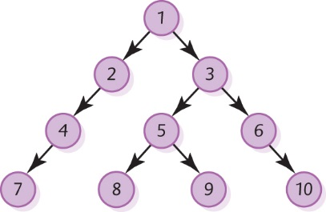
Trees (3 of 3)
Root node
Node with two children
Node with right child
Leaf node
A binary tree
What is the unique path
to the node containing
5? 9? 7? …
Node with left child

Slide 22
Binary Search Tree (1 of 5)
Binary Search Tree (BST)
A binary tree (shape property) that has the (semantic) property that characterizes the values in a node of a tree:
The value in any node is greater than the value in any node in its left subtree and less than the value in any node in its right subtree

Slide 23
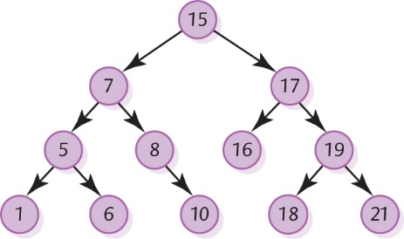
Binary Search Tree (2 of 5)
Each node
is the root
of a subtree
made up of
its left and
right children
A binary search tree

Slide 24
Binary Search Tree (4 of 5)
Boolean IsThere(current, item)
If (current is null)
return false
Else
Set result to item.compareTo(info(current))
If (result is equal to 0)
return true
Else
If (result < 0)
IsThere(item, left(current))
Else
IsThere(item, right(current))

Slide 25
Binary Search Tree (5 of 5)
Trace the
nodes passed
as you search
for 18, 8, 5,
4, 9, and 15
A binary search tree

Slide 26
Binary Search Tree (6 of 6)
IsThere(tree, item)
IF (tree is null)
RETURN FALSE
ELSE
IF (item equals info(tree))
RETURN TRUE
ELSE
IF (item < info(tree))
IsThere(left(tree), item)
ELSE
IsThere(right(tree), item)

Slide 27
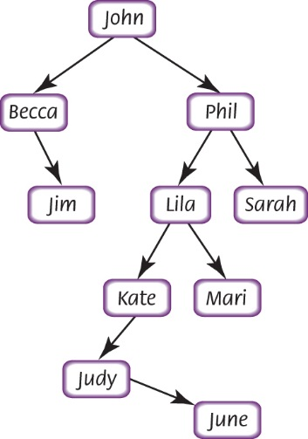
Building Binary Search Tree (1 of 3)
A binary search tree built from strings
27
Notes:
27

Slide 28
Building Binary Search Tree (2 of 3)
Insert(tree, item)
IF (tree is null)
Put item in tree
ELSE
IF (item < info(tree))
Insert (left(tree), item)
ELSE
Insert (right(tree), item)
28
Notes:
28

Slide 29
Building Binary Search Tree (3 of 3)
Print(tree)
If (tree is not null)
Print (left(tree))
Write info(tree)
Print (right(tree))
Is that all there is to it? Yes!
Remember we said that recursive
algorithms could be very powerful!

Slide 30
Graphs (1 of 4)
Graph
A data structure that consists of a set of nodes (called vertices) and a set of edges that relate the nodes to each other
Undirected Graph
A graph in which the edges have no direction
Directed Graph (Digraph)
A graph in which each edge is directed from one vertex to another (or the same) vertex

Slide 31
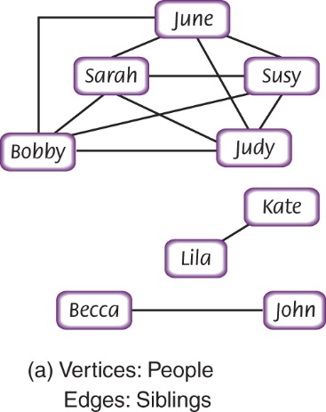
Graphs (2 of 4)
Examples of graphs

Slide 32
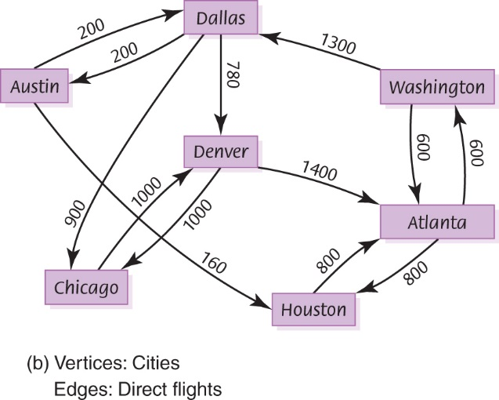
Graphs (3 of 4)
Examples of graphs

Slide 33
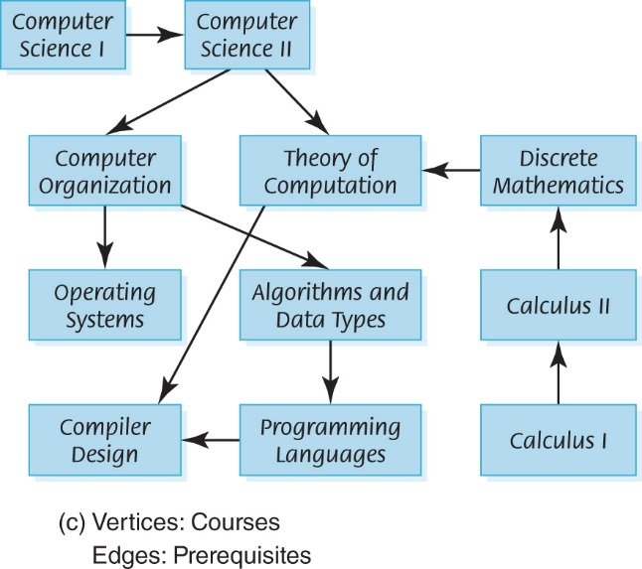
Graphs (4 of 4)
Examples of graphs

Slide 34
Graph Algorithms
A Depth-First Searching Algorithm: Given a starting vertex and an ending vertex, we can develop an algorithm that finds a path from startVertex to endVertex
This is called a depth-first search because we start at a given vertex and go to the deepest branch and explore as far down one path before taking alternative choices at earlier branches

Slide 35
Depth First Search(startVertex, endVertex)
Set found to FALSE
Push(myStack, startVertex)
WHILE (NOT IsEmpty(myStack) AND NOT found)
Pop(myStack, tempVertex)
IF (tempVertex equals endVertex)
Write endVertex
Set found to TRUE
ELSE IF (tempVertex not visited)
Write tempVertex
Push all unvisited vertexes adjacent with tempVertex
Mark tempVertex as visited
IF (found)
Write "Path has been printed"
ELSE
Write "Path does not exist")

Slide 36
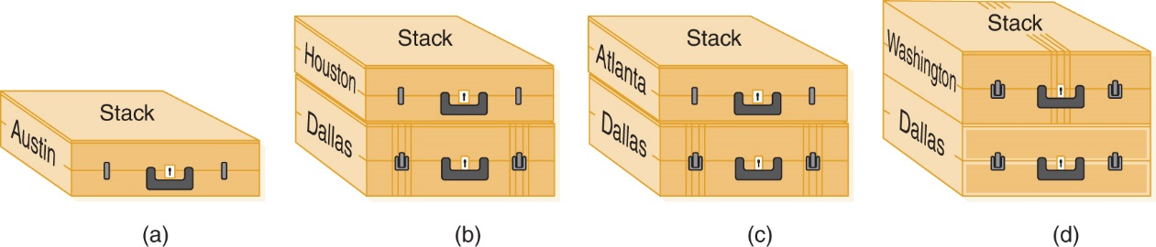
Can We Get From Austin to Washington? (1 of 2)
Using a stack to store the routes

Slide 37
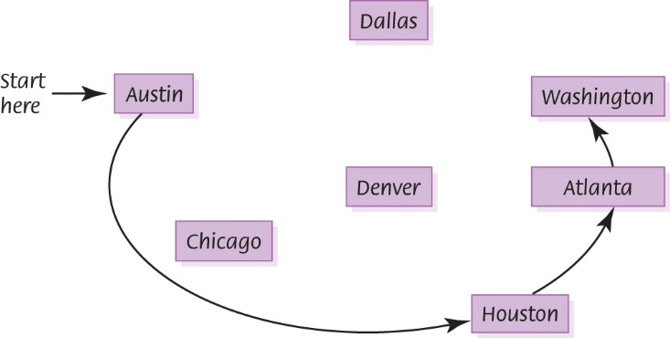
Can We Get From Austin to Washington? (2 of 2)
The depth-first search

Slide 38
Breadth-First Search
What if we want to answer the question of how to get from City X to City Y with the fewest number of airline stops?
A Breadth-First Search answers this question
A Breadth-First Search examines all of the vertices adjacent with startVertex before looking at those adjacent with those adjacent to these vertices
A Breadth-First Search uses a queue, not a stack, to answer this above question Why??

Slide 39
Breadth First Search(startVertex, endVertex)
Set found to FALSE
Enque(myQueue, startVertex)
WHILE (NOT IsEmpty(myQueue) AND NOT found)
Deque(myQueue, tempVertex)
IF (tempVertex equals endVertex)
Write endVertex
Set found to TRUE
ELSE IF (tempVertex not visited)
Write tempVertex
Enque all unvisited vertexes adjacent with tempVertex
Mark tempVertex as visited
IF (found)
Write "Path has been printed"
ELSE
Write "Path does not exist"

Slide 40
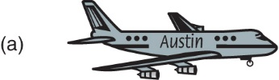
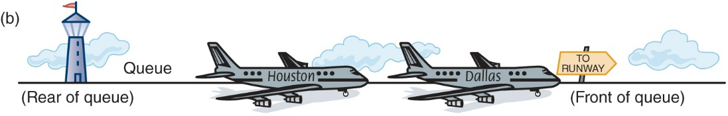
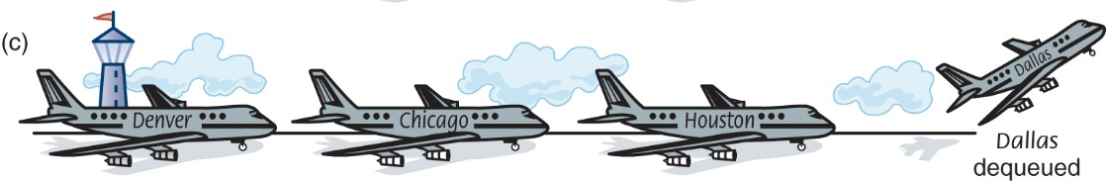
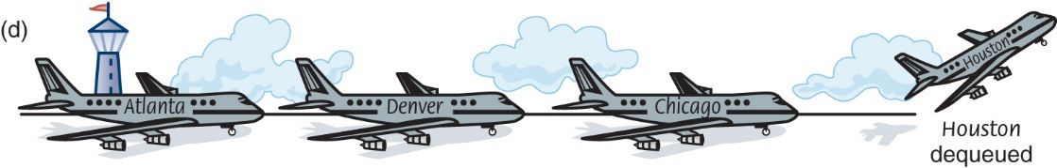
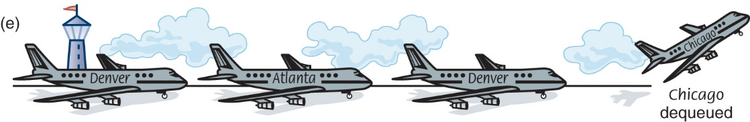
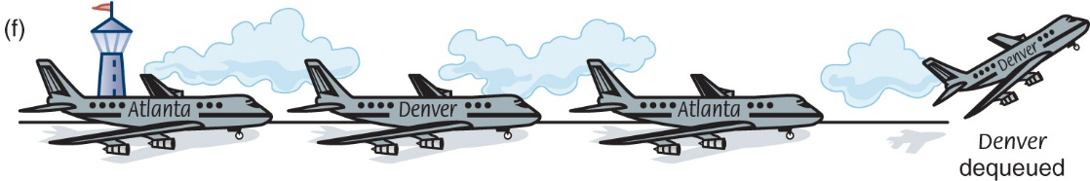
How Can I Get From Austin To Washington In The Fewest Number Of Stops?
Using a queue to store routes

Slide 41
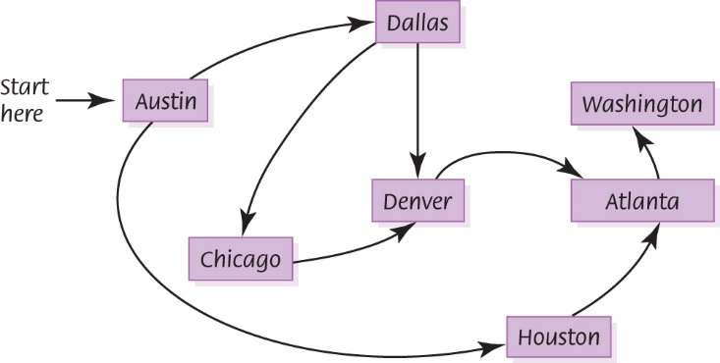
Breadth-First Search Traveling from Austin To Washington, DC
The breadth-first search

Slide 42
Subprogram Statements (1 of 5)
We can give a section of code a name and use that name as a statement in another part of the program
When the name is encountered, the processing in the other part of the program halts while the named code is executed
Remember?

Slide 43
Subprogram Statements (2 of 5)
What if the subprogram needs data from the calling unit?
Parameters
Identifiers listed in parentheses beside the subprogram declaration; sometimes called formal parameters
Arguments
Identifiers listed in parentheses on the subprogram call; sometimes called actual parameters

Slide 44
Subprogram Statements (3 of 5)
Value Parameter
A parameter that expects a copy of its argument to be passed by the calling unit
Reference Parameter
A parameter that expects the address of its argument to be passed by the calling unit

Slide 45
Subprogram Statements (4 of 5)
Insert(list, item) // Subprogram definition
Set list.values[length-1] to item
Set list.length to list.length + 1
Insert(myList, value) // Calling statement
Which parameter must be by reference?
45
Notes:
45

Slide 46
Ethical Issues
Workplace Monitoring
Do privacy rights extend to the workplace?
What is employee Internet monitoring?
Have you been monitored in the workplace?
How is email equivalent to DNA?

Slide 47
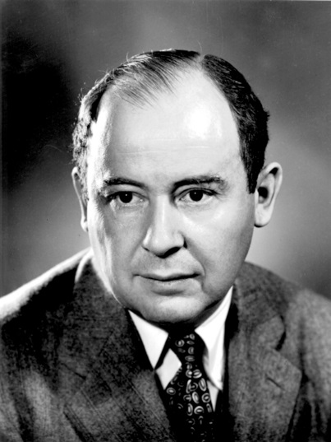
Who Am I?
In the 1940s, the new
computer architecture
I developed revolutionized
the design of computers.
Today’s computers are
referred to as [my last
name] machines
because the architectural
principles I described have
proven very successful.
Courtesy of the U.S. Department of Energy.

Slide 48
Do You Know?
How did Kealing Middle School use mobile phones to lower students’ resting heart rates?
What is peer-to-peer funding?
What branch of mathematics is being used in terrorist detection?
What is an EAN message?
What are lending clubs, and how do they bring down borrowing costs for Main Street businesses?
How did the 2007 Economic Stimulus Package provide a feast day for scammer?
What is the difference between a hacker and a cracker?

